Slide 1
ADA BOOST ALGORITHM
REGRESSION

Slide 2
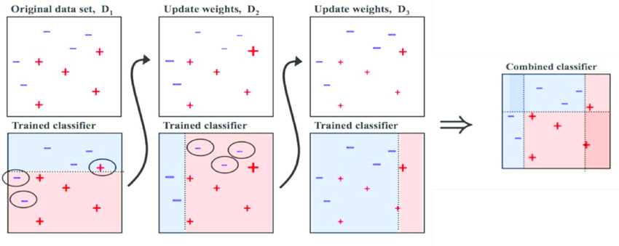
An AdaBoost regressor is a meta-estimator that begins by fitting a regressor on the original dataset and then fits additional copies of the regressor on the same dataset but where the weights of instances are adjusted according to the error of the current prediction.

Slide 3
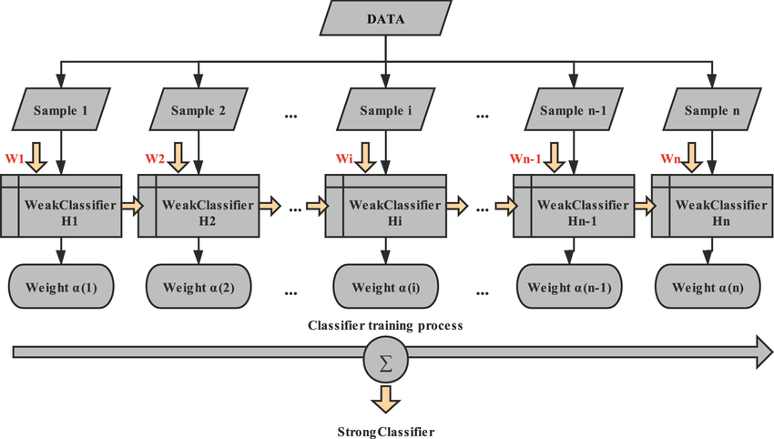
The flow chart of the Ada Boost Algorithm

Slide 4
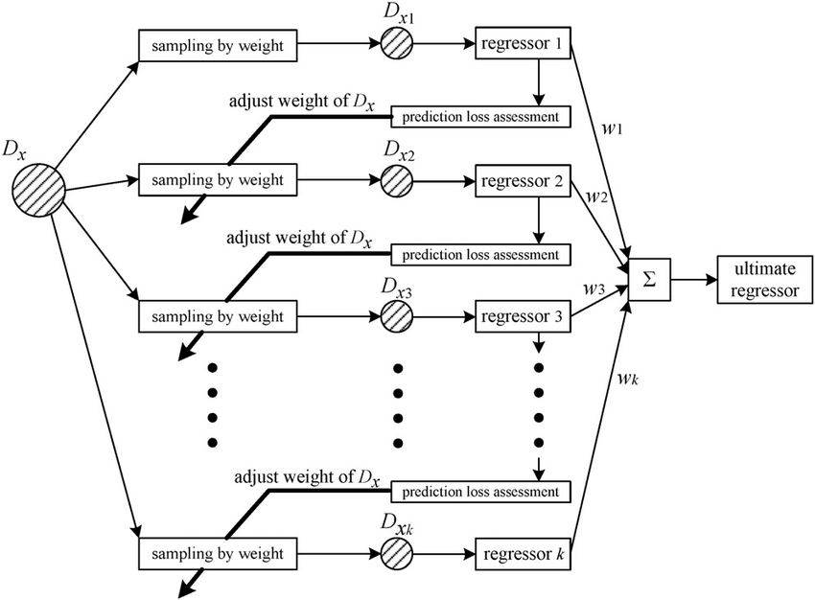
Schematic Diagram of AdaBoost Regression

Slide 5
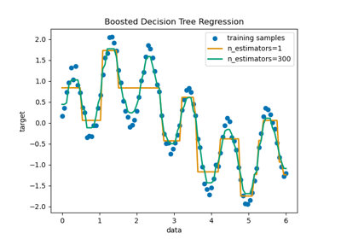
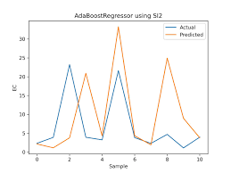
Boosted and Line Graph for Ada Boost

Slide 6
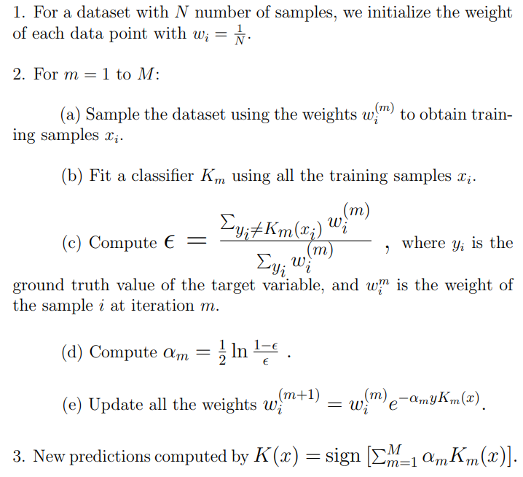
Mathematical understand of Ada Boost

